Slide 1
Diffusion Unit 1
Baseball in Korea

Slide 2
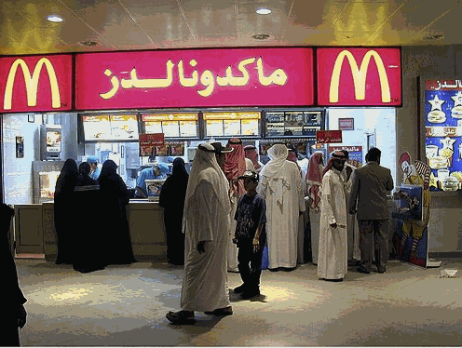
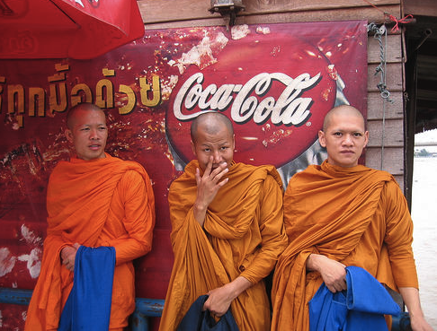
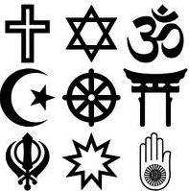
Cultural Diffusion
Cultural diffusion, or spatial diffusion, is the spread of an idea or innovation from its source to other cultures.
Diffusion occurs through the movement of people, goods or ideas.

Slide 3
DIFFUSION
RELOCATION DIFFUSION – spread by physical movement of people from one place to another
EXPANSION DIFFUSION – spread in an additive process

Slide 4
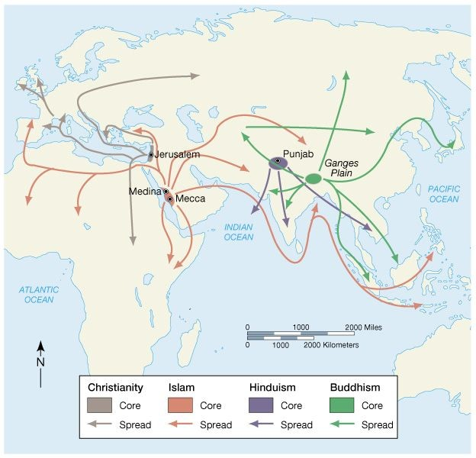
Connections Between Places
Hearth – place from which an innovation originates

Slide 6
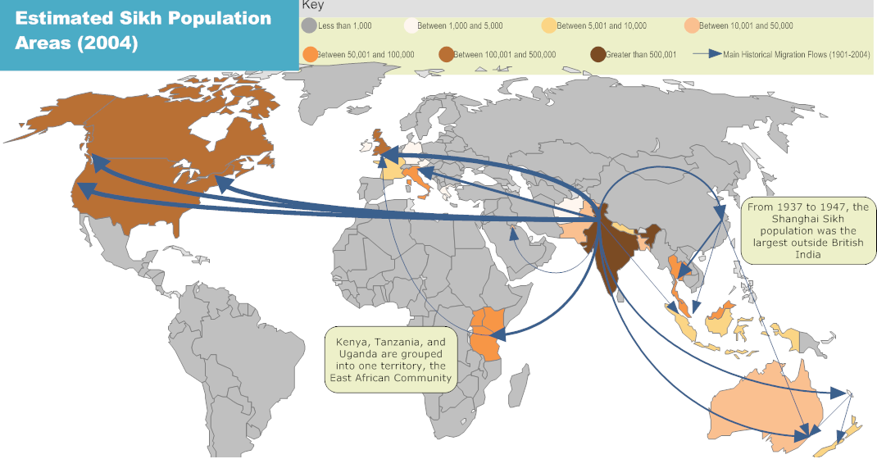
Relocation Diffusion
Spread of an idea through physical movement of people from one place to another
Examples: spread of baseball to Japan, spread of English to British Colonies, spread of AIDs to the U.S., spread of Catholicism to Latin America

Slide 7
Diffusion of culture - expansion
Expansion Diffusion is the spread of cultural traits or ideas through direct or indirect exchange without migration.
Contagious
Hierarchical
Reverse hierarchical
Stimulus

Slide 8
Diffusion of culture - Contagious
Contagious Diffusion occurs when a cultural trait spreads continuously outward from its hearth through contact among people
Example: Blues music, influenza, ideas on the internet
Diffusion of Blues -
Hearth – southern United States
As musicians outside the hearth heard the music, they began to play it themselves
Slowly spread northward and eventually reached major cities such as St. Louis, Chicago, and New York

Slide 9
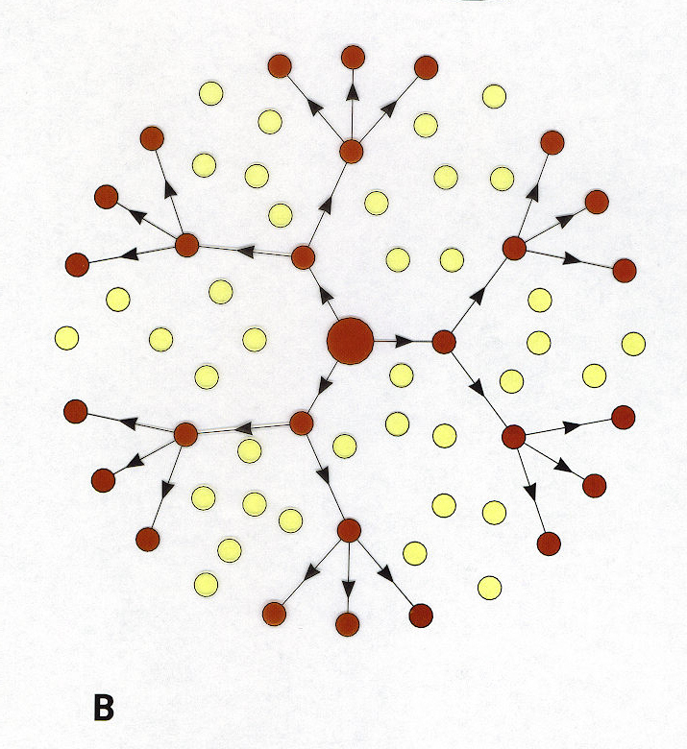
Diffusion of culture - Hierarchical
Hierarchical Diffusion is the spread of culture outward from the most interconnected places or from centers of wealth and importance.
First from one important person, city, or powerful class to another important person, city, or social class.
Eventually, the trait is shared with other people, smaller cities, social classes, or less developed countries.
Unlike contagious diffusion, hierarchical diffusion may skip some places while moving on to others.
Most popular culture (music, fashion, fads) follows this path.

Slide 10
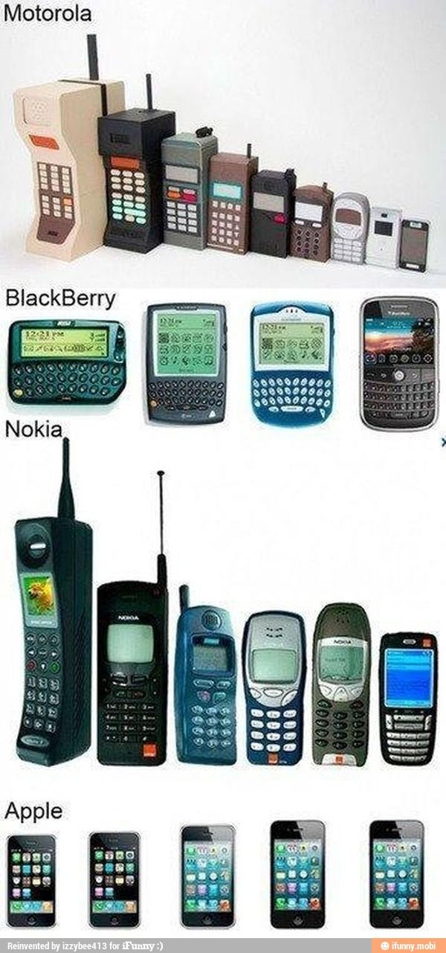
Diffusion of culture – Hierarchical
Example: cell phone technology
1980s – expensive and mostly owned by wealthy people in large cities in more developed countries (MDCs)
As cell phone networks grew and cell phones became more mass produced, they eventually spread to a wider market
Today, cell phones have diffused throughout the world

Slide 11
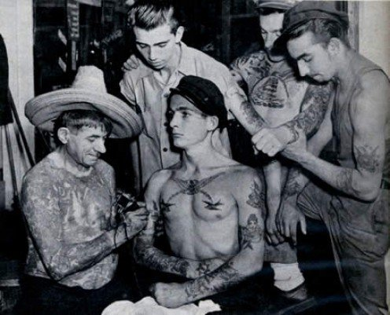
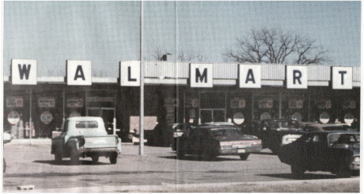
Diffusion of culture – Reverse Hierarchical
Reverse Hierarchical Diffusion is the processes in which a trait diffuses from a lower class to a higher class.
Example: tattoos
1940-1960, tattoos were a symbol of low social status and were associated with three types of places: seaport towns (dockworkers and sailors), military bases, and prisons.
1970s – the custom has diffused throughout many segments of society and geographic areas
Example: Walmart – from rural Arkansas to nearly every U.S. city

Slide 12
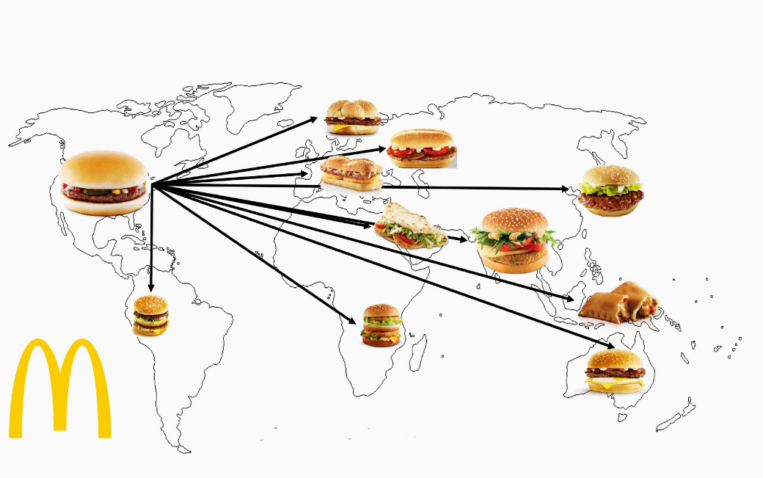
Diffusion of culture - Stimulus
Stimulus Diffusion occurs when people in a culture adopt an underlying idea or process from another culture, but modify it because they reject one trait of it.
Example: Europeans adopted the use of lightweight, beautiful porcelain dishes from China but rejected the high cost of importing them. So when Germans found the right type of clay to make their own, they modified the process of obtaining porcelain by making it in Europe.

Slide 13
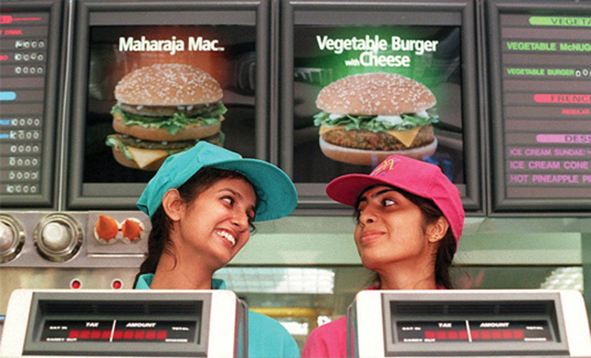
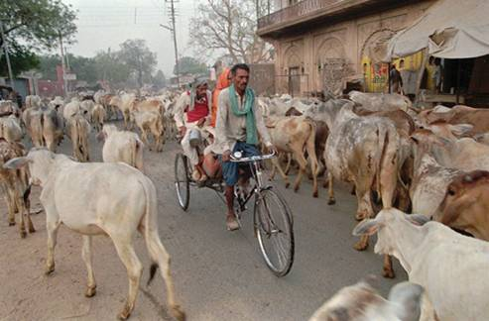
Stimulus Diffusion
Example: Hindus in India adopted the practice of eating fast food but rejected eating beef because it would violate their Hindu beliefs. They adapted by making vegetarian and other non-beef burgers.

Slide 14
Barriers to Diffusion
Distance
Physical barriers
Political barriers
Cultural barriers
Economic barriers
Amish

