Slide 1
Globalization Unit 1

Slide 2
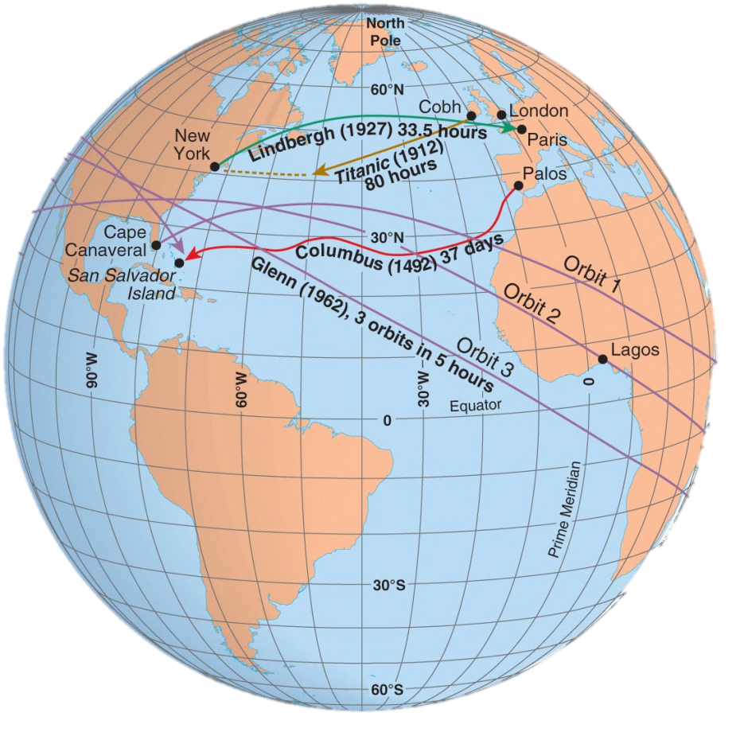
Space-Time Compression, 1492–1962
How has the time it takes to travel changed through the years? Why?

Slide 3
Distance
Distance and Time
Space-time compression is the shrinking “time distance” between locations because of improved methods of transportation and communication
Example: New York and London are separated by an ocean, but the development of air travel greatly reduced travel time between them and now feel much closer today than in the 19th century
Result: global forces are influencing culture everywhere and reducing local diversity more than ever before

Slide 4
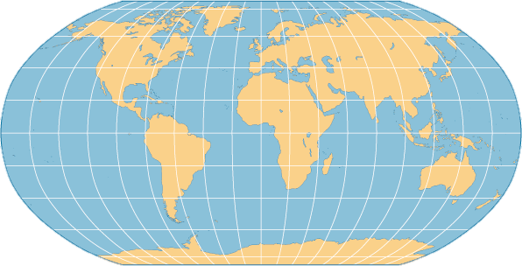
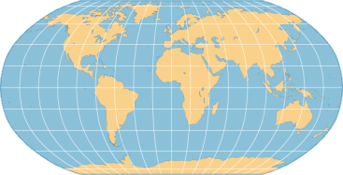
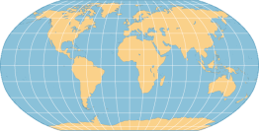
1500-1840
1850-1930
1950s
1960s
1980s

Slide 5
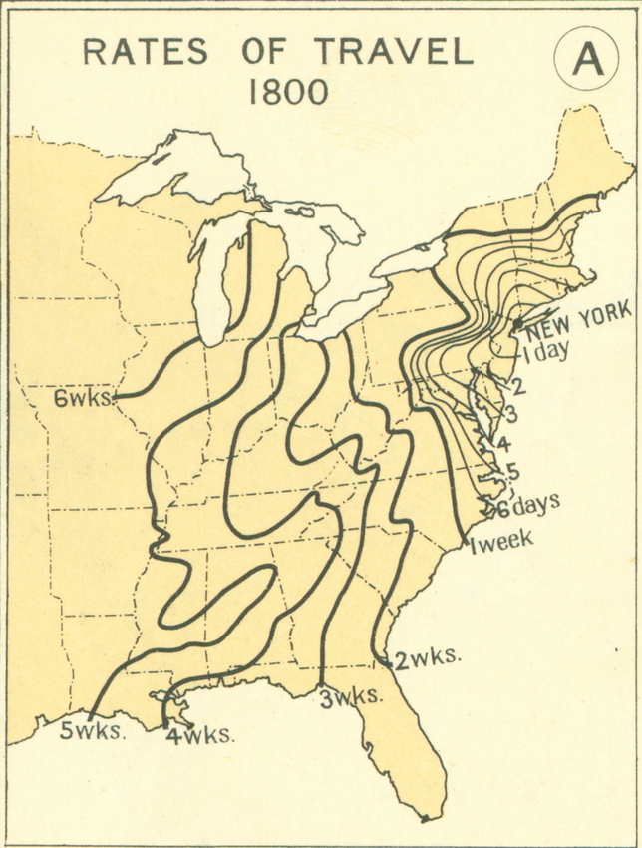

Slide 6
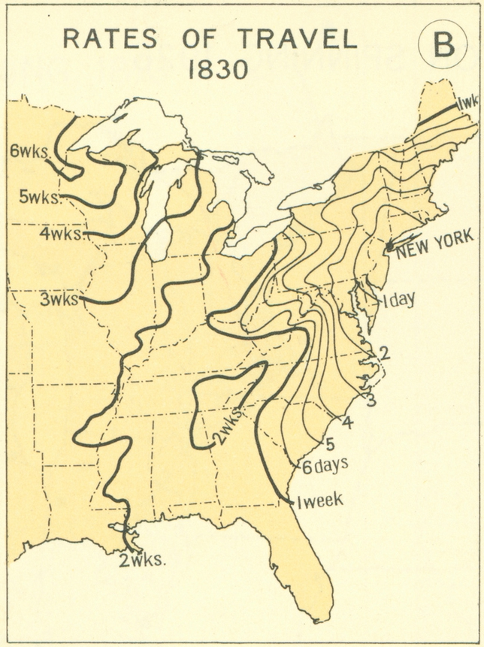

Slide 7
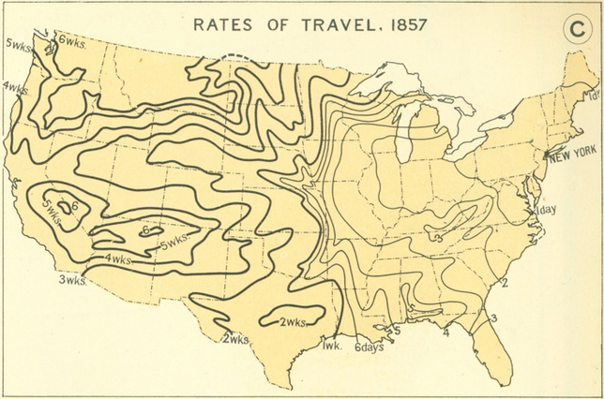

Slide 8
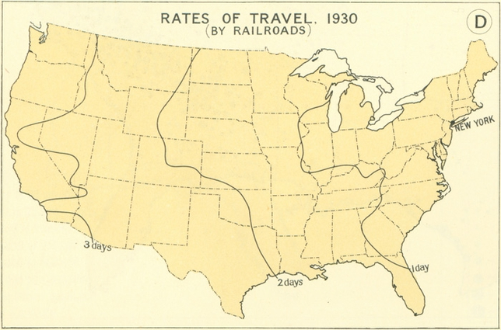
How long does it take today?

Slide 9
Distance
Distance and Connection
Spatial interaction refers to the contact, movement, and flow of things between locations – physical (through roads) or information (through radio or Internet)
The increasing connection between places is reflected in the growth of spatial interaction
The friction of distance indicates that when things are farther apart, they tend to be less well connected

Slide 10
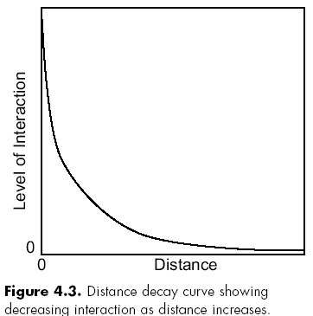
Distance
Distance-decay - Contact diminishes with increasing distance
Example: the weakening of a radio signal as it travels across space away from a radio tower – friction of distance causes the decay, or weakening, of the signal.
Improvements in transportation, communication, and infrastructure have reduced the friction as they have increased the spatial interaction.

Slide 11
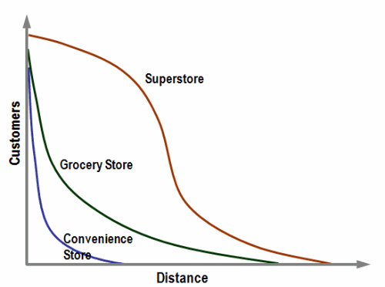
Distance Decay of Retail Stores
Distance-decay - Contact diminishes with increasing distance

Slide 12
Barriers to Diffusion
Distance
Physical barriers
Political barriers
Cultural barriers
Economic barriers

Slide 13
Name that Diffusion
Some scenarios may have more than one type of diffusion

Slide 14
Agenda, Jan. 17
Unit 1 Vocab Match
Globalization Article Tic-Tac-Toe
Globalization Response (in Verge)

Slide 15
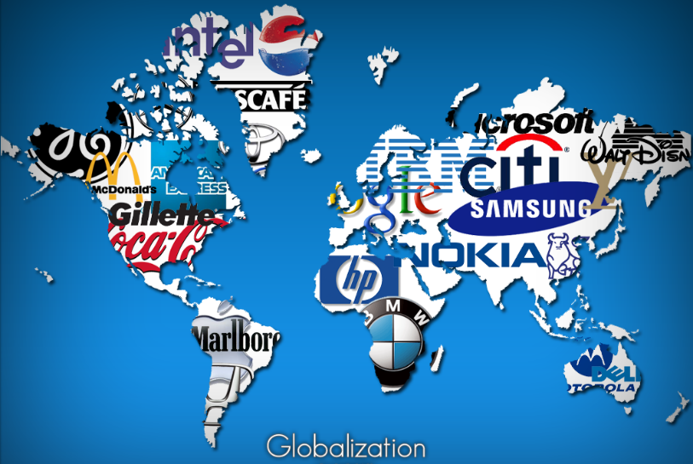
Globalization:
the increasing interconnectedness of people and places through the converging processes of economic, political, and cultural change
Notes:
Once distant countries, now linked through commerce, transpo, and communications.

Slide 16
Globalization:
the increasing interconnectedness of people and places through the converging processes of economic, political, and cultural change
Distant regions and cultures are now linked through travel, commerce, communications
Scale of the world is shrinking, in the ability of a person, object, or idea to interact with a person, object or idea
Through communications and transportation: reducing the friction of distance and barriers of worldwide exchange, reduction of costs have fallen rapidly
Notes:
Once distant countries, now linked through commerce, transpo, and communications.

Slide 17
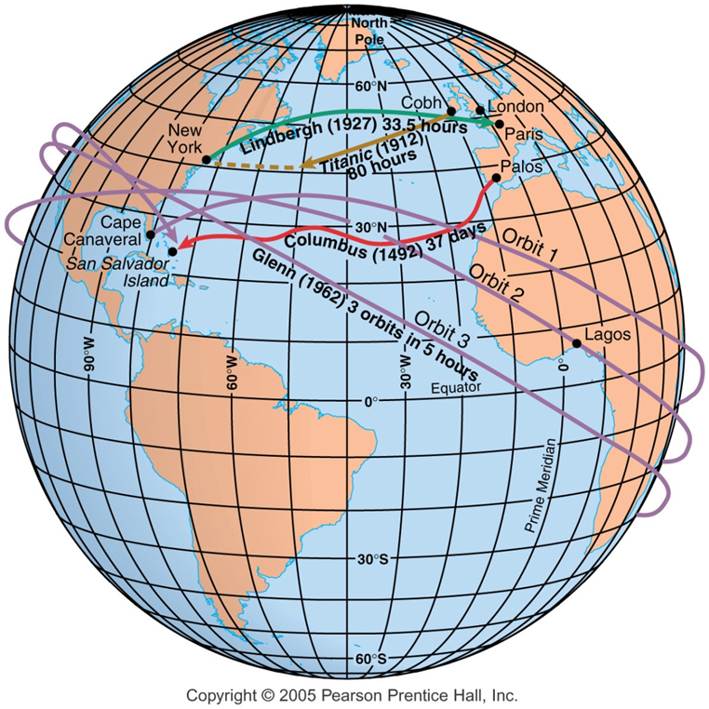
SPATIAL INTERACTION
Distance decay
Contact diminishes with increasing distance
Space-Time Compression
Reduction in time for something to reach another place
Uneven Development
increasing gap in economic conditions between regions
Notes:
Connection refers to relationships among people and objects across the barrier of space.
Diffusion is the process by which a characteristic spreads across space from one place to another overtime.
17

Slide 18
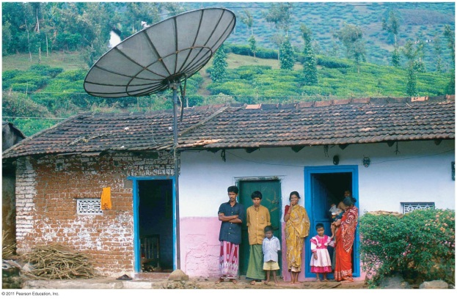
Globalization
Global Economy and Geopolitics
Finance and business intertwined globally
Transnational corporations
Globalization of labor
Housing bubble of 2009
Abundance of goods and services
Supranational organizations: EU, NATO, WTO, UN, IMF…
Global Culture
Increasingly uniform landscapes
Consumer culture, loss of folk culture
Fast food, gas stations, retail chains
Religions
English
What is the connection between globalization and diffusion?

Slide 19
SPEED Approach
Speed Approach to look at geographic issues:
S – Social
P – Political
E – Economic
E – Environmental
D – Demographic

Slide 20
Tic-Tac-Toe Must create tic-tac-toe with middle article
“A Map of Where Your Food Originated Might Surprise You” | “Brexit is Just the Latest Blow to Globalization” | “The Globalization of America’s Colleges”
“Column: The Bell of Globalization Cannot Be Un-rung” | “The Pros and Cons of Globalization” | “Globalization Challenges Asian Languages”
“Giant Christmas Displays Are Taking Over Malls Throughout Asia” | “How India Became America” | “The Great Unraveling of Globalization”

