Slide 1
World Geography
Unit 4 Political Geography
Source Set

Slide 2
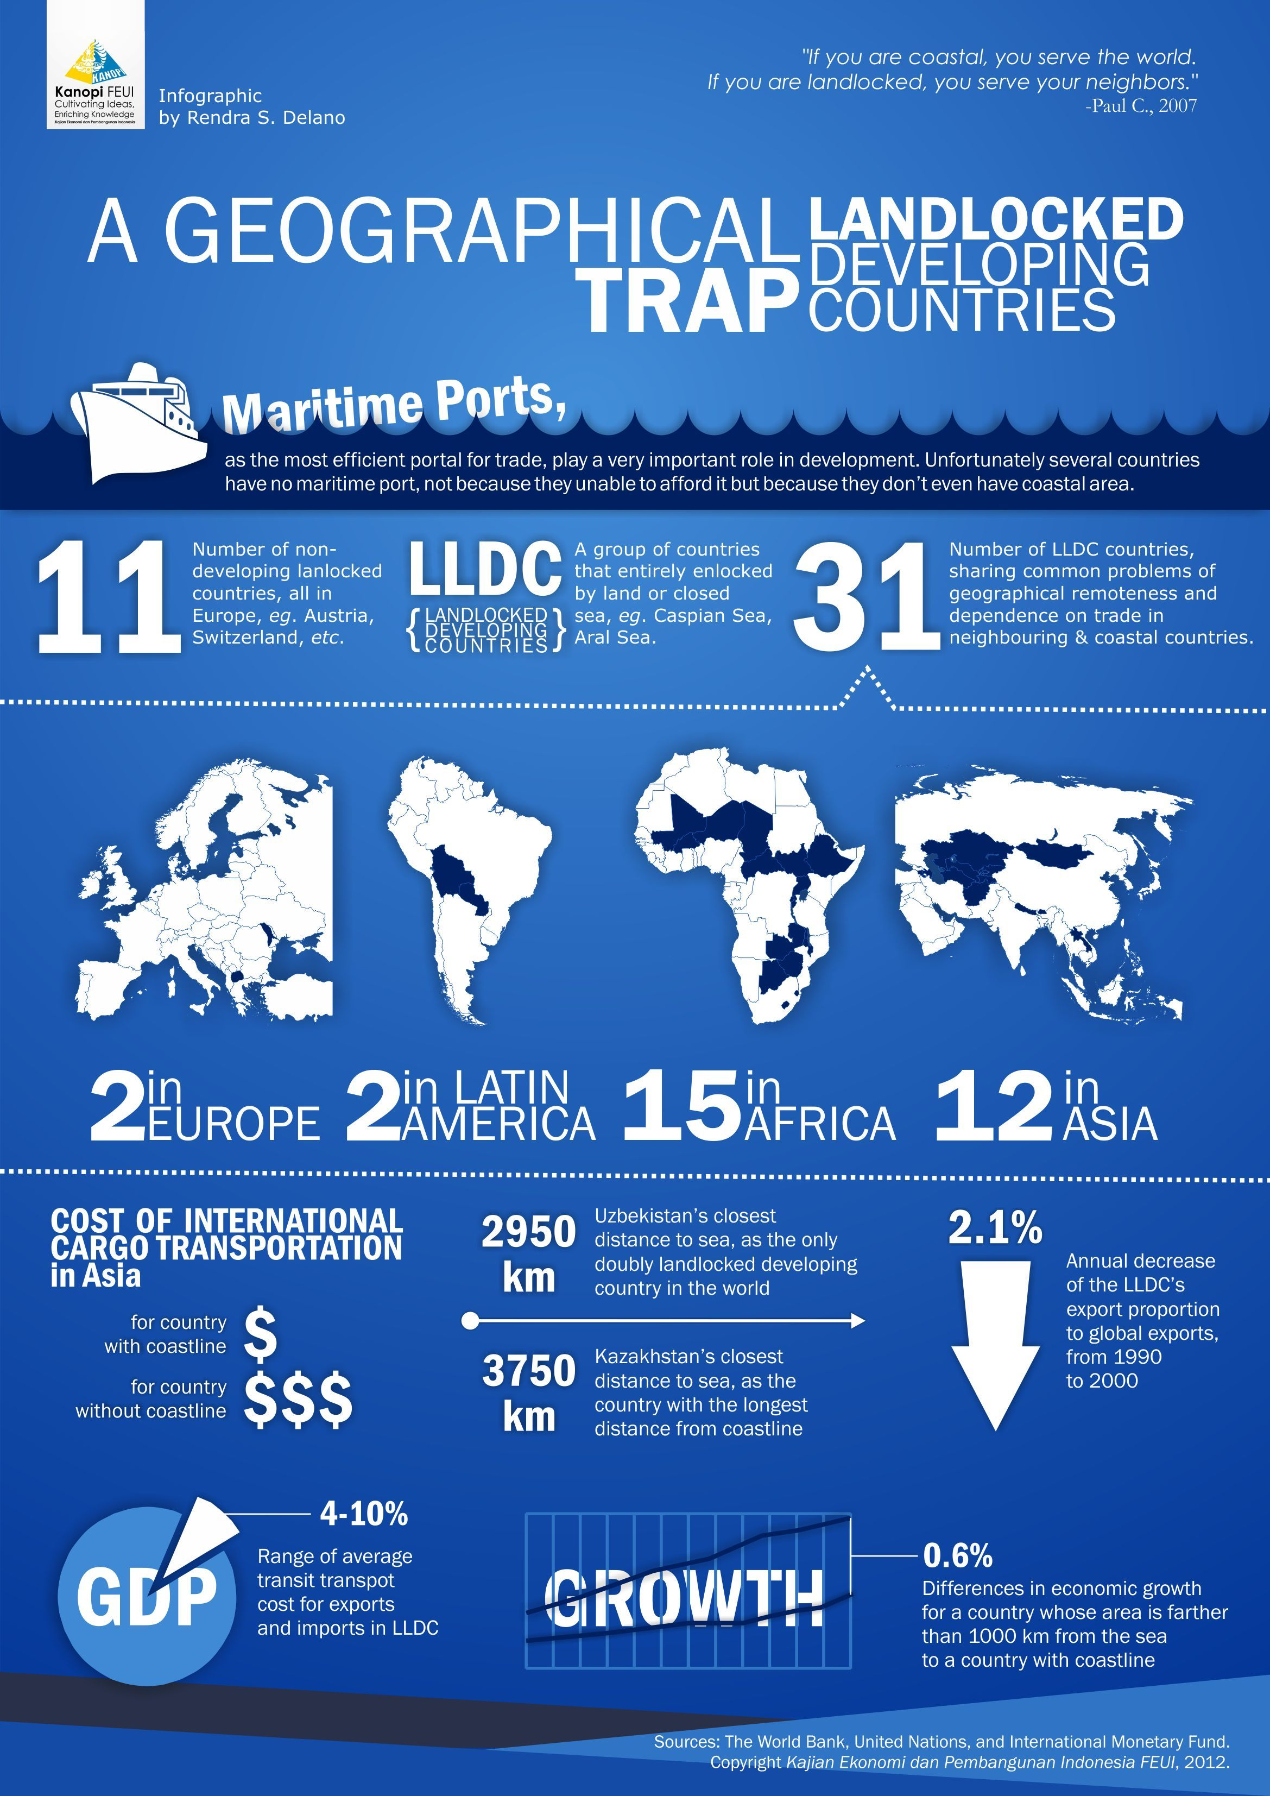
A Geographical Trap: Landlocked Developing Countries
Geographical location also determine economic development. This infographic shows disadvantages of landlocked countries.
Notes:
https://www.pinterest.com/pin/186477240792797975/

Slide 3
Notes:
Note: this is more impactful if you can zoom in to see border dates. https://c1.staticflickr.com/5/4596/24556520177_d5a5b6d97a_o.png

Slide 4
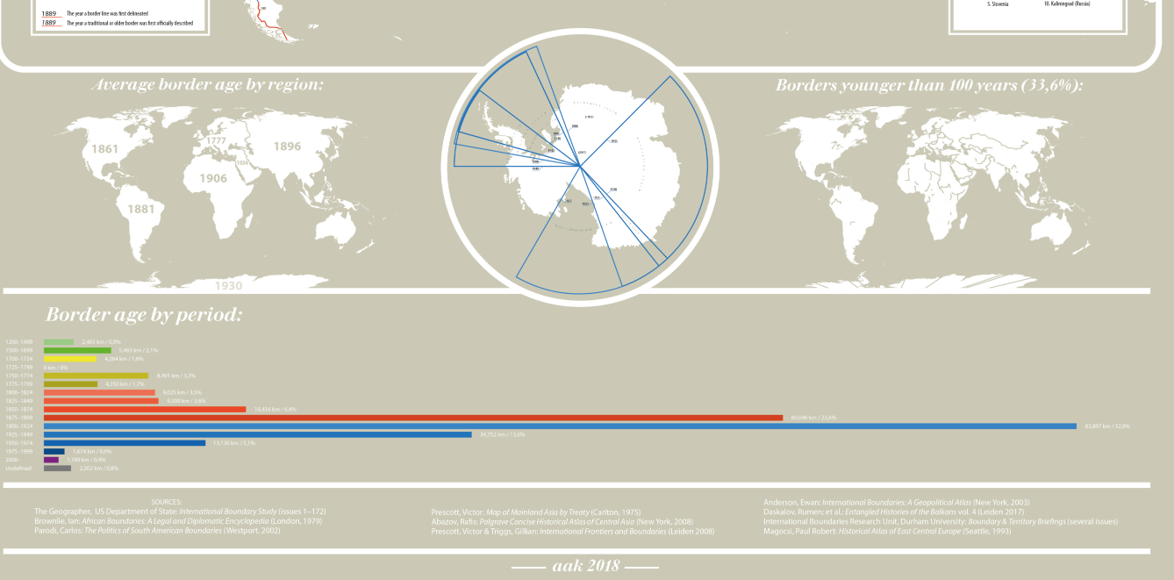

Slide 5
Examples of size, shape, and relative location

Slide 6
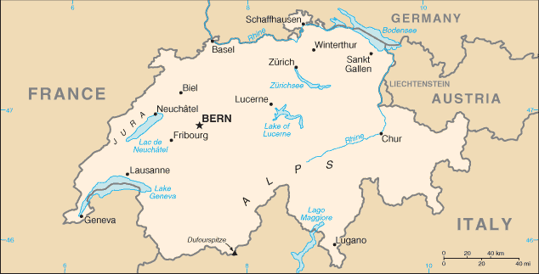
Compact and landlocked
Example: Switzerland
Notes:
CIA world factbook picture
Answers: Adv: central location with many border countries so trade and banking could be beneficial, multiple cultural influences, languages
Disadvantages: lack of access to resources/ocean, flying out of country requires permission from surrounding countries, subject to surrounding country’s government, law, trade, etc., difficulty in staying neutral

Slide 7
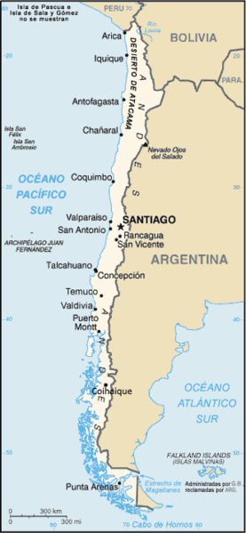
Elongated
Example: Chile
Notes:
CIA world factbook picture
Answers: Adv: has many climates, access to water and various neighbors,
Disadvantages: hard to govern a variety of needs with the varied topography and climates, if different parts of country have different levels of development, etc.

Slide 8
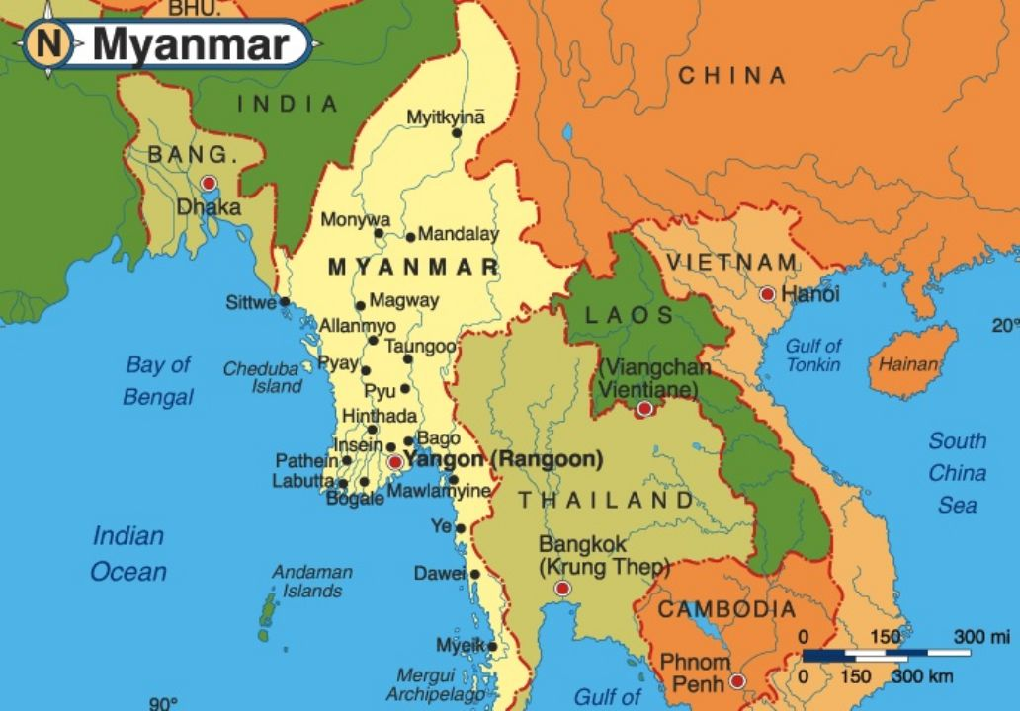
Prorupted
Example: Myanmar (Burma)

Slide 9
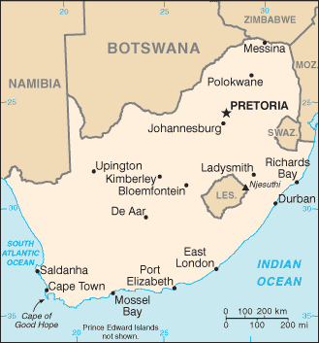
Perforated
Example: South Africa and Lesotho
Notes:
CIA world factbook picture
Answers: Adv: Lesotho can get aid from surrounding country especially if more developed
Disadvantages: lack of access to resources, flying out of country requires permission from surrounding country, subject to surrounding country’s government, law, trade, etc.

Slide 10
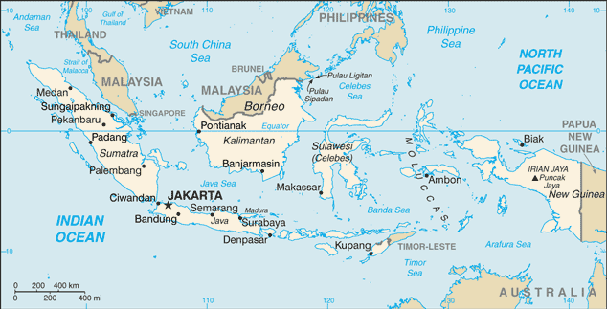
Fragmented
Example: Indonesia
Notes:
CIA world factbook picture
Answers: Adv: trade opportunities, access to water and various neighbors,
Disadvantages: hard to govern a variety of needs with the varied topography and climates, if different parts of country have different levels of development, hard to communicate and travel throughout islands, etc.

Slide 11
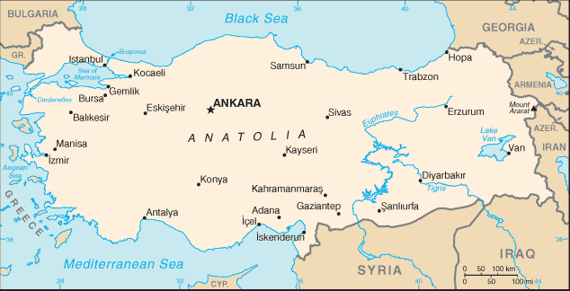
Relative location: connecting trade routes/continents
Example: Turkey
Notes:
CIA world factbook picture
Answers: Adv: able to flourish in trading routes, connects Europe and Asia, Cultural and technological diffusion/benefits from access to two continents, access to water
Disadvantages: if trade routes shift or change, strategic location so could be subject to more conflict, area disconnected across water

Slide 12
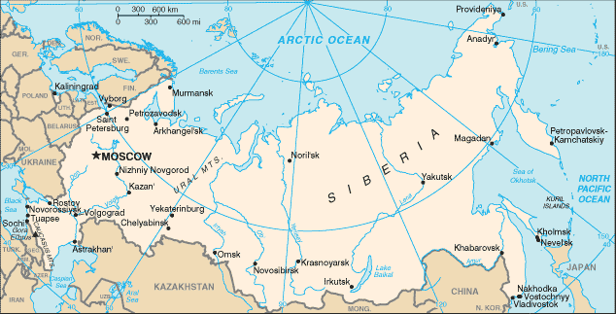
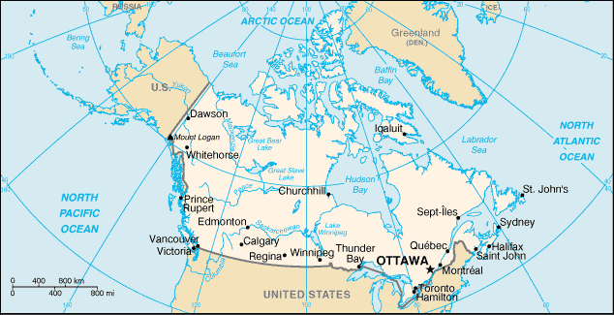
Large land area
Example: Russia, Canada
Notes:
CIA world factbook picture
Answers: Adv: trade opportunities, access to water and various neighbors, lots of land, possibly people, resources
Disadvantages: hard to govern a variety of needs with the varied topography and climates, if different parts of country have different levels of development, hard to communicate and travel throughout large area, the most area the more difficult to control, etc.

Slide 13
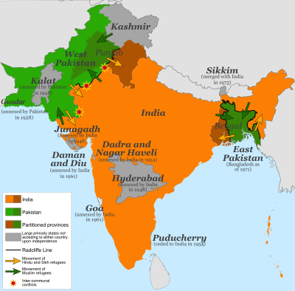
The Radcliffe Line was the boundary demarcation line between the Indian and Pakistani portions of the Punjab and Bengal provinces of British India. The demarcation line was published on 17 August 1947 upon the Partition of India. Today its western side still serves as the Indo-Pakistani border and the eastern side serves as the India-Bangladesh border.
https://en.wikipedia.org/wiki/Radcliffe_Line

Slide 14
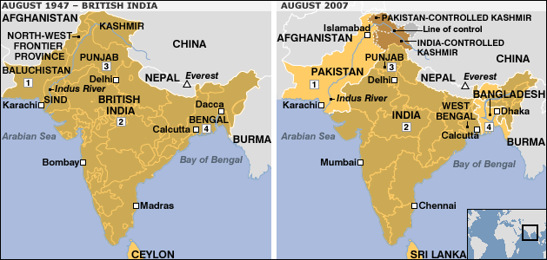
1. Dominion of Pakistan created on 14 August 1947. Became world's first Islamic Republic in 1956. New city of Islamabad replaced Karachi as capital in the mid 60s
2. British India was made up of provinces, princely states and state agencies. An independent Union of India was created on 15 August 1947 and renamed the Republic of India in 1950
3. Punjab was split in two. Majority Muslim western part became Pakistan's Punjab province; majority Sikh and Hindu eastern part became India's Punjab state
4. Bengal divided into Indian state of West Bengal and East Pakistan, which became East Bengal in 1956 and Bangladesh achieved independence after a civil war in 1971
Notes:
http://news.bbc.co.uk/2/hi/in_depth/629/629/6922293.stm

Slide 15
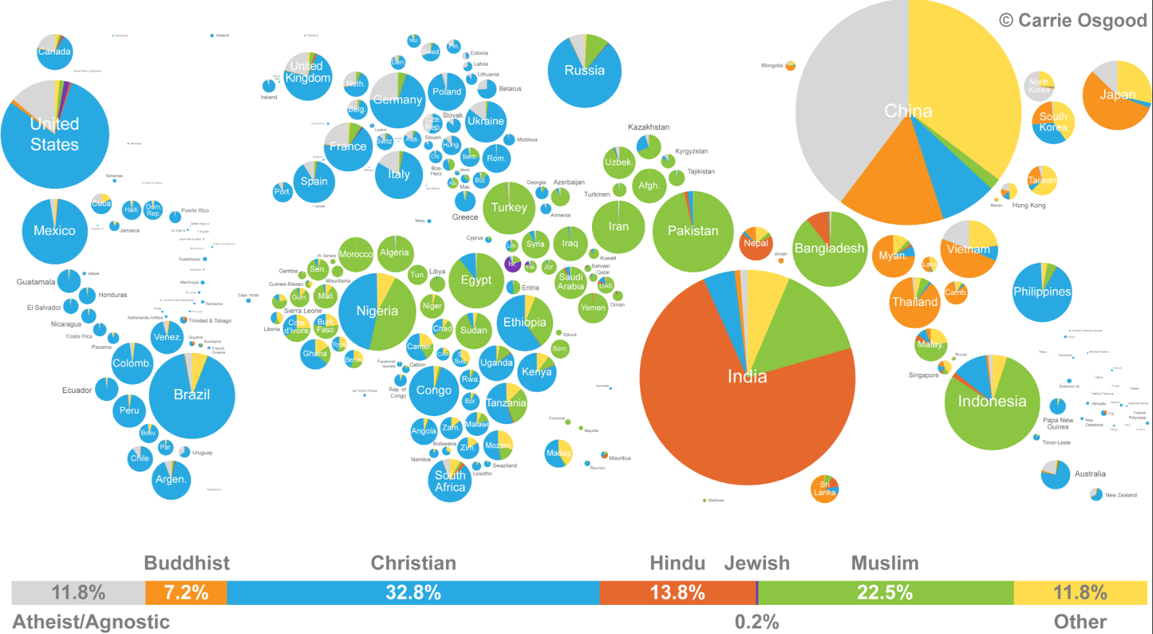
World Religions 2013
Notes:
Source: http://carrieonadventures.com/inspiration/graphics/worldreligions-detailed.png Permission to use© 2013 by Carrie Osgood | CLO Communications Data sources are the United Nations Population Fund and the World Religion Database, both using 2010 figures.

